Slide 1
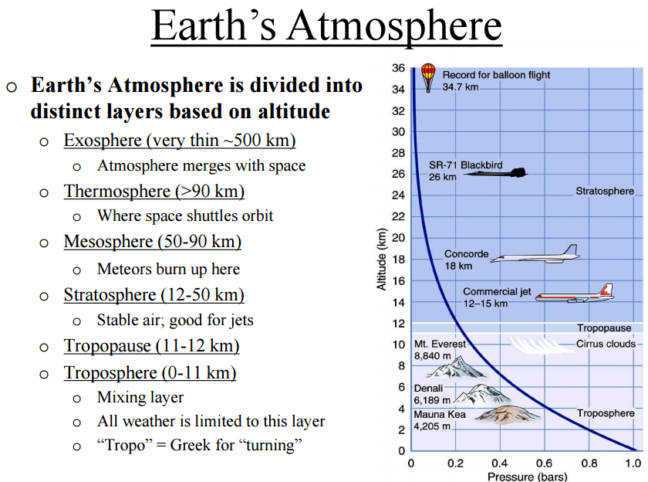


Slide 2
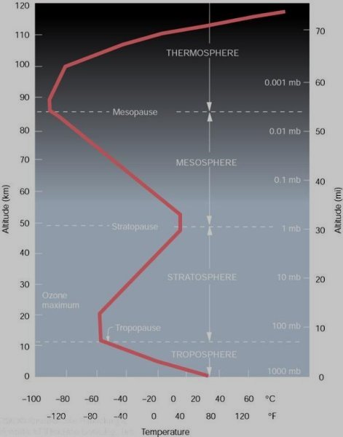
Atmospheric Layers
`
Troposphere
Tropopause
Stratosphere
Stratopause
Mesosphere
Mesopause
Thermosphere
Exosphere
Notes:
So far, we have seen that both air pressure and air density decrease with height above the earth
Air temperature has a more complicated vertical profile.
Look at this diagram, notice that air temp normally decreases from the surface up to about 11 km (36,000 ft) or 7 mi.
This decrease in air temp with increasing height is due mainly to the fact that the sunlight warms the earth’s surface and the surface then warms the air above it.
The rate at which air temp decreases with height is called Lapse Rate. The standard lapse rate is about 3.6F per 1000 ft of rise. Note this is only an average and is not always the case.
There are times when air temperature actually increases with height. This condition is known as a temperature inversion. We use radiosondes to measure the day to day changes in the lapse rate.

Slide 3
Atmospheric Layers
Temperature decreases with altitude – called the environmental lapse rate
6.5˚C per kilometer (average)
3.5˚F per 1000 feet (average)
Thickness varies – average height is about 12 km
Tropopause separates Troposphere from
Stratosphere. Generally higher in summer
Lower in winter.
Troposphere – Temp decrease w/ height
Most of our weather occurs in this layer
Varies in height around the globe
Notes:
So far, we have seen that both air pressure and air density decrease with height above the earth
Air temperature has a more complicated vertical profile.
Look at this diagram, notice that air temp normally decreases from the surface up to about 11 km (36,000 ft) or 7 mi.
This decrease in air temp with increasing height is due mainly to the fact that the sunlight warms the earth’s surface and the surface then warms the air above it.
The rate at which air temp decreases with height is called Lapse Rate. The standard lapse rate is about 3.6F per 1000 ft of rise. Note this is only an average and is not always the case.
There are times when air temperature actually increases with height. This condition is known as a temperature inversion. We use radiosondes to measure the day to day changes in the lapse rate.

Slide 4
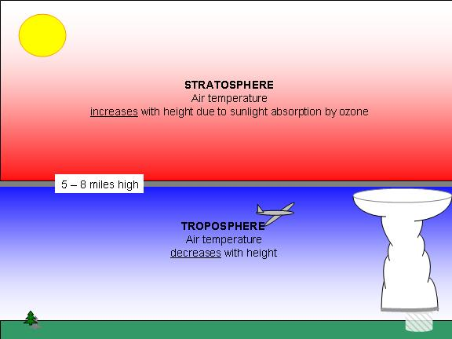
The troposphere is the lowest major atmospheric layer, and is located from the Earth's surface up to the bottom of the stratosphere. It has decreasing temperature with height (at an average rate of 3.5° F per thousand feet (6.5 ° C per kilometer); whereas the stratosphere has either constant or slowly increasing temperature with height.

Slide 5
Atmospheric Layers
Extends from about 16 Km to about 56 Km above the sea level
Boundary b/w troposphere and stratosphere is called tropopause
Once material injected into remain for years e.g. ammonium sulfate aerosols at 20 Km
Important feature is presence of a thin layer ozone
Solar UV rays absorbed and converted into heat
Stratosphere
Temperature inversion in stratosphere
Ozone plays a major part in heating the air
At this altitude
Notes:
So far, we have seen that both air pressure and air density decrease with height above the earth
Air temperature has a more complicated vertical profile.
Look at this diagram, notice that air temp normally decreases from the surface up to about 11 km (36,000 ft) or 7 mi.
This decrease in air temp with increasing height is due mainly to the fact that the sunlight warms the earth’s surface and the surface then warms the air above it.
The rate at which air temp decreases with height is called Lapse Rate. The standard lapse rate is about 3.6F per 1000 ft of rise. Note this is only an average and is not always the case.
There are times when air temperature actually increases with height. This condition is known as a temperature inversion. We use radiosondes to measure the day to day changes in the lapse rate.

Slide 6
Atmospheric Layers
Extends from 56 Km to about 90 Km
Boundary b/w stratosphere and mesosphere is called stratopause
Very low concentration of O₂ and N₂
Symmetrical structure they possess little capacity to absorb solar radiation
Temperature decreases with elevation
Mesosphere
Middle atmosphere – Air thin, pressure low,
Need oxygen to live in this region. Air quite Cold -90°C (-130°F) near the top of mesosphere
Notes:
So far, we have seen that both air pressure and air density decrease with height above the earth
Air temperature has a more complicated vertical profile.
Look at this diagram, notice that air temp normally decreases from the surface up to about 11 km (36,000 ft) or 7 mi.
This decrease in air temp with increasing height is due mainly to the fact that the sunlight warms the earth’s surface and the surface then warms the air above it.
The rate at which air temp decreases with height is called Lapse Rate. The standard lapse rate is about 3.6F per 1000 ft of rise. Note this is only an average and is not always the case.
There are times when air temperature actually increases with height. This condition is known as a temperature inversion. We use radiosondes to measure the day to day changes in the lapse rate.

Slide 7
Atmospheric Layers
Thermosphere
“Hot layer” – oxygen molecules absorb energy from solar Rays warming the air. Very few atoms and molecules in this Region.
Above mesopause zone of atmosphere is called thermosphere
Boundary b/w mesosphere and thermosphere is called mesopause
Contain oxygen ions (O⁺), molecular oxygen ions (O₂⁺), and molecular nitrogen ions (N₂⁺)
These ions absorb invisible short wave solar radiation
Notes:
So far, we have seen that both air pressure and air density decrease with height above the earth
Air temperature has a more complicated vertical profile.
Look at this diagram, notice that air temp normally decreases from the surface up to about 11 km (36,000 ft) or 7 mi.
This decrease in air temp with increasing height is due mainly to the fact that the sunlight warms the earth’s surface and the surface then warms the air above it.
The rate at which air temp decreases with height is called Lapse Rate. The standard lapse rate is about 3.6F per 1000 ft of rise. Note this is only an average and is not always the case.
There are times when air temperature actually increases with height. This condition is known as a temperature inversion. We use radiosondes to measure the day to day changes in the lapse rate.

Slide 8
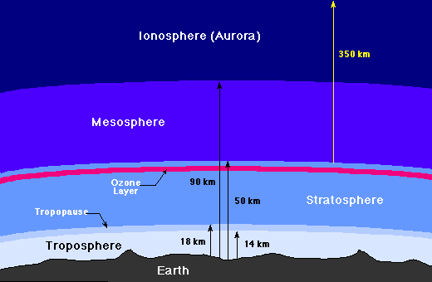
The Stratosphere and Ozone Layer
Above the troposphere is the stratosphere, where air flow is mostly horizontal. The thin ozone layer in the upper stratosphere has a high concentration of ozone, a particularly reactive form of oxygen. This layer is primarily responsible for absorbing the ultraviolet radiation from the Sun. The formation of this layer is a delicate matter, since only when oxygen is produced in the atmosphere can an ozone layer form and prevent an intense flux of ultraviolet radiation from reaching the surface, where it is quite hazardous to the evolution of life. There is considerable recent concern that manmade flourocarbon compounds may be depleting the ozone layer, with dire future consequences for life on the Earth.
Ionosphere
Above the stratosphere is the mesosphere and above that is the ionosphere (or thermosphere), where many atoms are ionized (have gained or lost electrons so they have a net electrical charge). The ionosphere is very thin, but it is where aurora take place, and is also responsible for absorbing the most energetic photons from the Sun

Slide 9
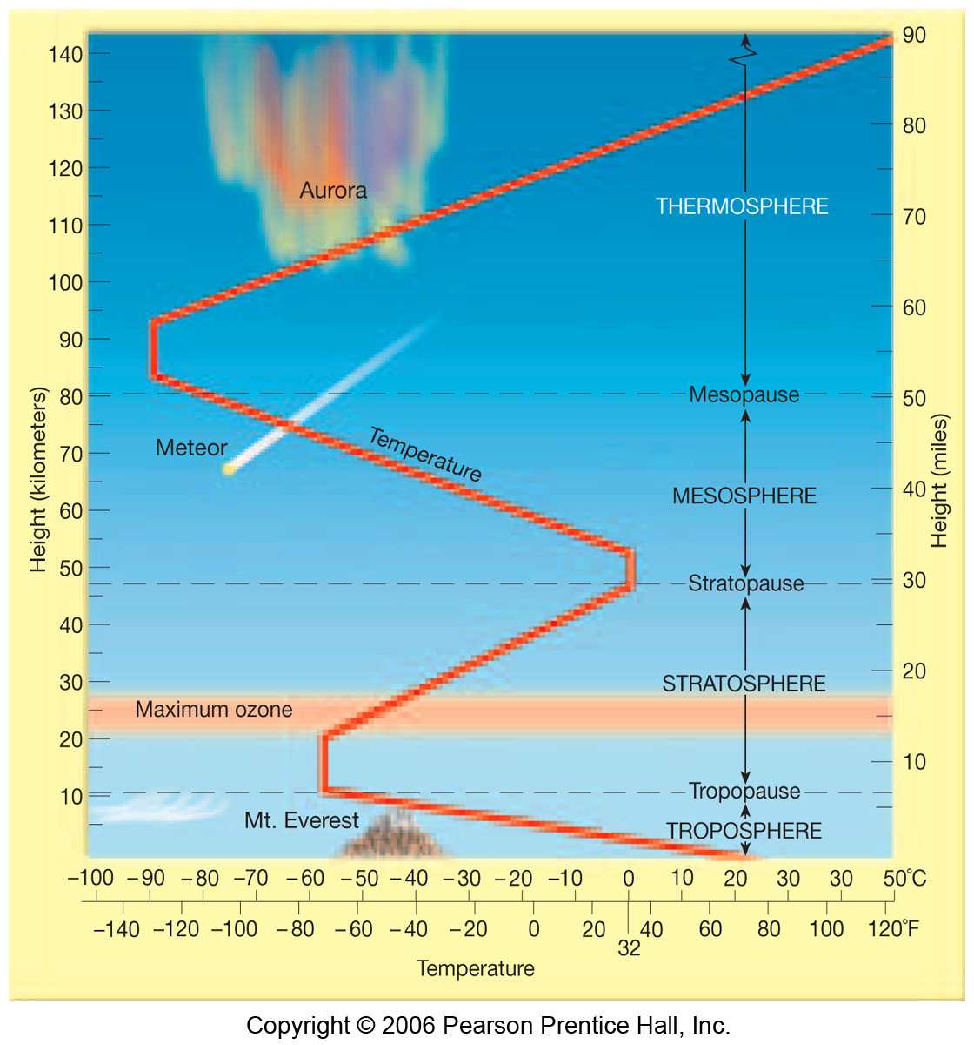
Thermal structure of the atmosphere

